Slide 1

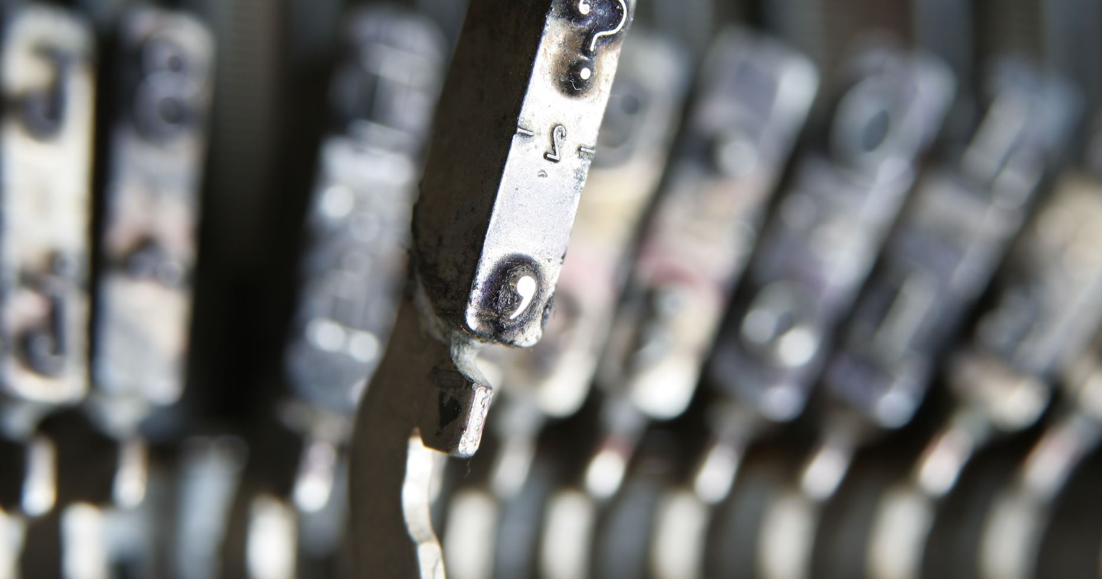
Intelligent Handwritten Digit Identification System For Computer Applications
PRESENTED BY :
Team No:CSE-005
18UK1A0516- GANTA SUCHENDAR REDDY
18UK1A0525- KANKATI PRANITHA
18UK1A0535- MUSHIKA SAIRAM
18UK1A0576- JANAGANI VAMSHI KRISHNA

Slide 2
OUTLINE
INTRODUCTION
OBJECTIVE
TECHINICAL ARCHITECTURE
NEURAL NETWORKS
DATA
MODEL BUILDING
IBM WATSON STUDIO
SOFTWARE REQUIREMENTS
CONCLUSION

Slide 3
INTRODCTION
Handwriting recognition is one of the compelling research works going on because every individual in this world has their own style of writing. It is the capability of the computer to identify and understand handwritten digits or characters automatically. Because of the progress in the field of science and technology, everything is being digitalized to reduce human effort.
Hence, there comes a need for handwritten digit recognition in many real-time applications. MNIST data set is widely used for this recognition process, and it has 70000 handwritten digits. We use Artificial neural networks to train these images and build a deep learning model. Web application is created where the user can upload an image of a handwritten digit this image is analyzed by the model and the detected result is returned on to UI

Slide 4
OBJECTIVE
By the end of this Project you will:
You will know fundamental concepts and techniques of the Artificial Neural Network and Convolution Neural Networks
You will gain a broad understanding of image data
You will work with Sequential type of modeling
You will work with Keras capabilities
and work with image processing techniques
You will know how to build a web application using the Flask framework

Slide 5
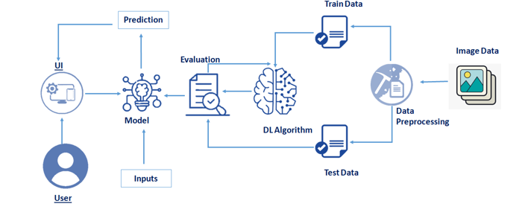
Technical Architecture

Slide 6
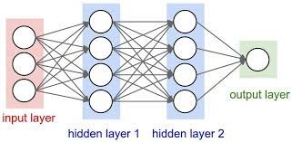
NEURAL NETWORKS
Artificial neural networks usually called neural networks (NNs) are interconnected systems composed of many simple processing elements (neurons) operating in parallel whose function is determined by-
1) Networks Structure
2) Connection Strengths
3) The Processing performed at computing elements or nodes

Slide 7
DATASET
ML depends heavily on data, without data, it is impossible for a machine to learn. It is the most crucial aspect that makes algorithm training possible. In Machine Learning projects, we need a training data set. It is the actual data set used to train the model for performing various actions. TensorFlow already has MNIST Data set so there is no need to explicitly download or create Dataset
The MNIST dataset contains ten classes: Digits from 0-9. Each digit is taken as a class

Slide 8
MODEL BUILDING
This activity includes the following steps
Initializing the model
Adding CNN Layers
Training and testing the model
Saving the model

Slide 9
MODEL BUILDING DESCRIPTION
Add CNN Layers Creating the model and adding the input, hidden, and output layers to it
Compiling The Model
With both the training data defined and model defined, it's time to configure the learning process. Compilation requires 3 arguments: an optimizer, a loss function, and a list of metrics.
Train the model
Now, we will train our model with our image dataset

Slide 10
MODEL BUILDING DESCRIPTION
Observing The Metrics
Test The Model
Save The Model
Test With Saved Model

Slide 11
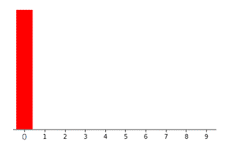

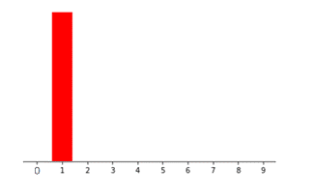

OUTPUT:
Recognized digit is []:
Digit recognition :
If we choose the image ‘0’ we get as
If we choose the image ‘0’ we get as

Slide 12
IBM Watson Studio
IBM Acquired soft layer, a public cloud platform, to serve as the foundation for its IaaS offering. In October 2016, IBM rolled the soft layer brand under its Blue mix brand of PaaS offerings, giving users to access both IaaS and PaaS resources from a single console. IBM cloud provides a full-stack, public cloud platform with various products in the catalog, including options for compute, storage, networking, end to end developer solutions for app development, testing and deployment, security databases, and cloud native services.
We Created the IBM cloud account by going to the IBM cloud login page. Then we login to IBM Watson Studio and deployed our model on IBM.

Slide 13
Advantages of deploying model on CLOUD
Security and privacy. Much like a private cloud, you can ensure your data remains secure when you are the only organization that uses the private portion of your infrastructure
Security and privacy. Much like a private cloud, you can ensure your data remains secure when you are the only organization that uses the private portion of your infrastructure
Potential cost savings
Superior flexibility and scalability.

Slide 14
SOFTWARE REQUIREMENTS
Anaconda navigator
Jupyter notebook
Machine learning tools: Numpy, Tensorflow, Keras.
IBM Watson Studio

Slide 15
CONCLUSION
In this project we have identified the image and build an Automatic Handwritten Digit Recognition. So, we used artificial neural networks train these images and build a deep learning model.

Slide 16

THANK YOU

